Slide 1
Internet Of Things – Python Programming
KAMYAAB JAWAN PAKISTAN
Introduction to Python Programming

Slide 2
Introduction to Python Programming
Python is a Dynamic Language: Python is a dynamic language for the beginner to advance level programmers and supports the development of a wide range of applications include
Simple text processing applications
Functional applications
Object-Oriented base applications
Web applications
GUI base applications
Interactive Gaming programming.

Slide 3
History of Python
Python was developed by Guido van Rossum in the late eighties and early nineties at the National Research Institute for Mathematics and Computer Science in the Netherlands.
Python is derived from many other languages, including ABC, Modula-3, C, C++, Algol-68, SmallTalk, and Unix shell and other scripting languages.
Python is copyrighted. Like Perl, Python source code is now available under the GNU General Public License (GPL).

Slide 4
Python Features
Easy-to-learn: Python has few keywords, simple structure, and a clearly defined syntax. This allows the student to pick up the language quickly.
Easy-to-read: Python code is more clearly defined and visible to the eyes.
Easy-to-maintain: Python code is fairly easy to maintain. You don’t have to put all the source python files at one place.

Slide 5
Python Features
Interactive Mode: Python has support for an interactive mode which allows interactive testing and debugging of snippets of code.
Portable: Python can run on a wide variety of hardware platforms and has the same interface on all platforms.
Extendable: You can add low-level modules to the Python interpreter. These modules enable programmers to add to or customize their tools to be more efficient.

Slide 6
Python Features
Databases: Python provides interfaces to all major commercial databases.
GUI Programming: Python supports GUI applications that can be created and ported to many system calls, libraries and windows systems, such as Windows, Macintosh, Unix, Linux.
Scalable: Python provides a better structure and support for large programs than shell scripting.

Slide 7
Python Features
Apart from the above-mentioned features, Python has a big list of good features, few are listed below:
It supports functional and structured programming methods as well as OOP.
It can be used as a scripting language or can be compiled to byte-code for building large applications.
It provides very high-level dynamic data types and supports dynamic type checking.
IT supports automatic garbage collection.
It can be easily integrated with C, C++ and Java.

Slide 8
Getting Python
The most up-to-date and current source code, binaries, documentation, news, etc., is available on the official website of Python https://www.python.org/
You can download Python documentation from https://www.python.org/doc/. The documentation is available in HTML, PDF format

Slide 9

Installing Anaconda (Python Distribution)
Anaconda is a python distribution for large-scale data processing, predictive analytics, and scientific computing.
It can be downloaded from the website url
https://repo.continuum.io/archive/

Slide 10
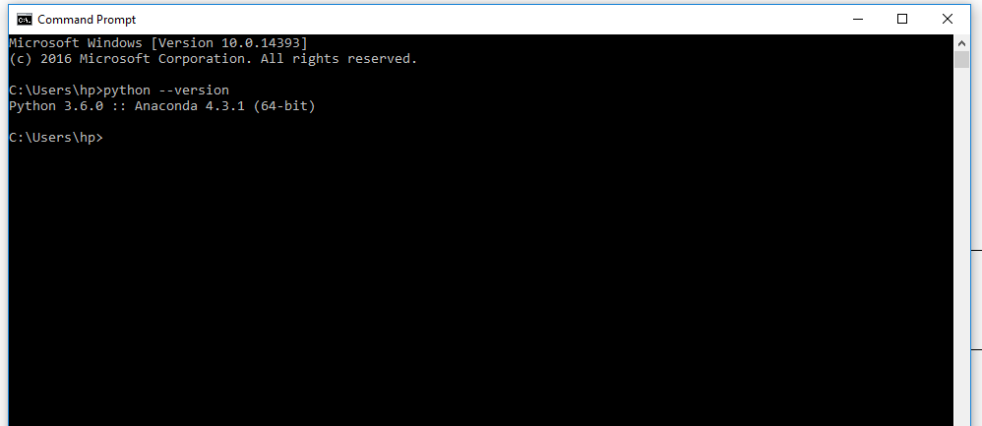
Checking Python & Anaconda Install
Using python - -version command in terminal to check version of python and Anaconda install

Slide 11
Graphical IDE for Python Professional Developers
PyCharm IDE by JetBrains
PyCharm is an Integrated Development Environment (IDE) used in computer programming, specifically for the Python language.
It is developed by the Czech company JetBrains. It provides code analysis, a graphical debugger, an integrated unit tester, and supports web development with Django.
It can be download from the official JetBrains website.
https://www.jetbrains.com/pycharm/download/

Slide 12
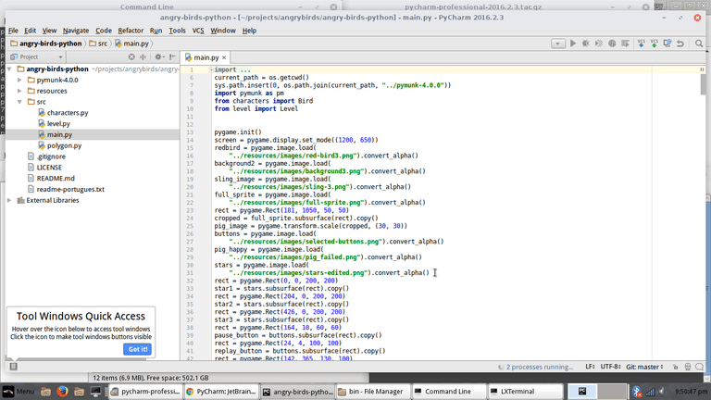
PyCharm IDE Environment

Slide 13
First Python Program
Make a first Hello World python program in PyCharm
Create a helloWorld.py python file
Basic Syntax
print("Hello Python world!!!") OR
print(‘Hello Python world!!!’)
Output
Hello Python world!!
(NOTE: Python also accept single-quotation in print() statement)

Slide 14
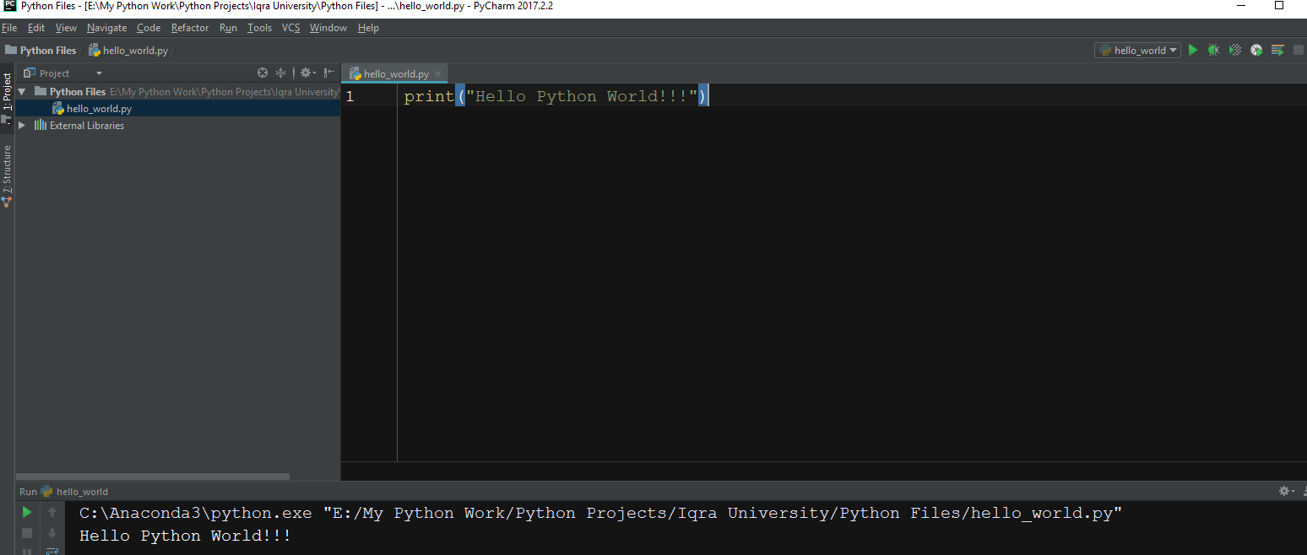
First Python Program

Slide 15
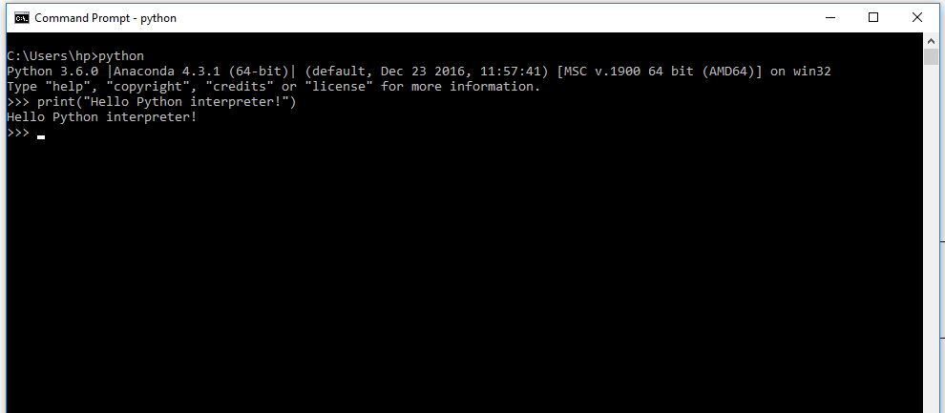
Running Python in a Terminal Session

Slide 16
Multiple Print() statement in python
print("Hello ”)
print(“Python ”)
print(“World”)
print(“Iqra”+”University”)
Output
Hello
Python
World
IqraUniversity

Slide 17
Using end= option in print() statement
print("Hello”,end=“”)
print(“Python”)
print(“World”)
Output
HelloPython
World

Slide 18
Comments in Python
Comments are use for documentation and better understand of source in native language
Single Line Comments in Python
# Prints Hello Python World on to screen
print("Hello Python world!!!")
Multi-Line Comments in Python
Multi-Line comment don’t actually exist in python
You can comment multiple lines as follows −
# First comment
# Second comment

Slide 19
Escape Sequences in Python
Escape Sequences are use for formatting text in print() statement.
Type of escape sequences are \n,\t,\b,\’,\”
print(“Hello\nWorld”)
Hello
World
print(“Hello\tWorld”) >> Hello World
print(“Hello\bWorld”) >> HellWorld
print(“Hello \’World\’ ”) >> Hello ‘World’
print(“Hello \”World\” “) >> Hello “World”
(NOTE: These escape sequences can be use in end= option in print())

